Slide 1

Photo Sharing Mobile UI (Draft UI)
LINH LUU (68697438)
BACH VU (25082165)

Slide 2
5 sketches of establishing a connection between devices

Slide 3
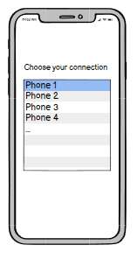
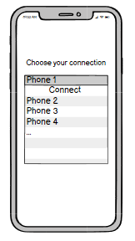
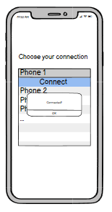


DESIGN 1

Slide 4
STRENGTH
Provides a visual feedback for user by highlight colour on the section of device that user clicks to connect.
Sufficient colour contrast for text with the background.
DRAWBACK
Slow / unnecessary step to connect.
Difficult to find a wanted device to connect if the number of users are large (such as > 15) due to missing search key name engine.
Unable to re-do connect command.

Slide 5
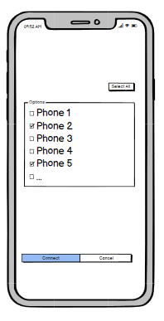
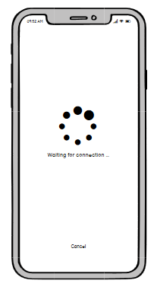
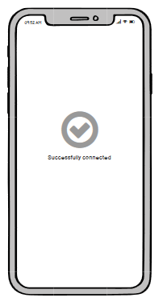

DESIGN 2

Slide 6
STRENGTH
Able to select multi-devices to connect.
Sufficient colour contrast for text with the background.
Provides feedback on interactions via loading indicator, highlight when a user clicks on the connect button, etc.
DRAWBACK
Devices in list have to be reloaded, but no reload command for client (restart app?)
Difficult to find a wanted device to connect if the number of users are large (such as > 10) due to no search key name engine.

Slide 7
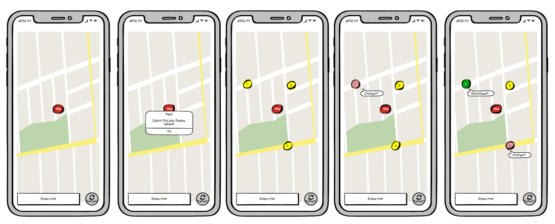








DESIGN 3

Slide 8
STRENGTH
Possible to see the location of the device nearby in 1km.
Able to share multi-devices.
Provides feedback to help people know what an app is doing now.
Prominent graphics by using GPS!
DRAWBACK
Could be come overload with widgets at public place (100 client online at same time).
Difficult to find a wanted device to connect if the number of users are large (such as > 15) due to no search key name engine.

Slide 9
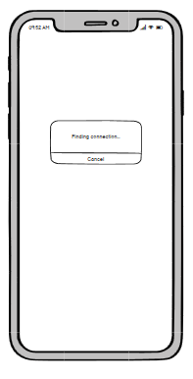
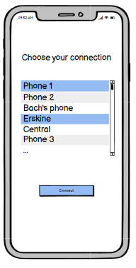
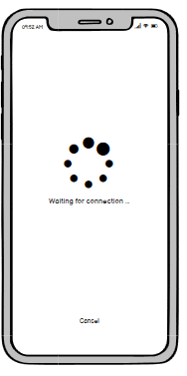
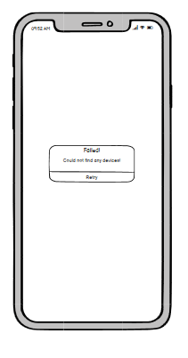





DESIGN 4

Slide 10
STRENGTH
Sufficient colour contrast for text with the background.
Allow to connect to more than one device.
Provide visual feedback to know what devices are chosen to connect and feedback on interaction via loading indicator.
DRAWBACK
- List of devices must be preload when launch app. If new device go online, need reload app to refresh list of device.

Slide 11
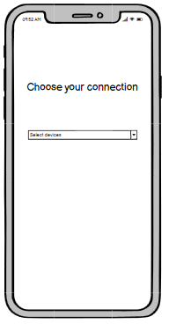
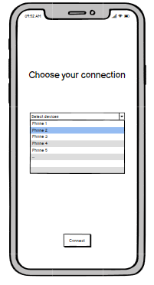
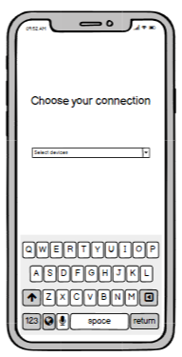
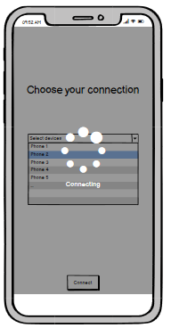



DESIGN 5

Slide 12
STRENGTH
Sufficient colour contrast for text with the background.
Search by name/IP work fine in public places.
DRAWBACK
The combo box creates one more step (click to see the list of connecting devices) which is quite redundant.
Could not cancel the connection processing.
Target is too small to hit.

Slide 13
5 sketches of selecting & sharing photos

Slide 14
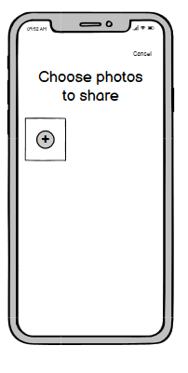
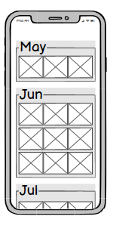
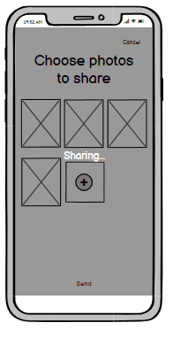
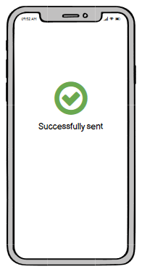


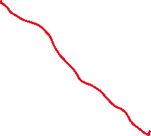
DESIGN 1

Slide 15
STRENGTH
Provides feedback to notice when the processing is executed and completed.
Clear review of selected images before send (in case duplicate item chosen).
DRAWBACK
Unable to cancel the images once you have chosen and selected sharing.

Slide 16
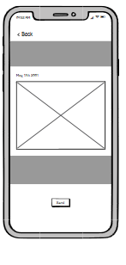
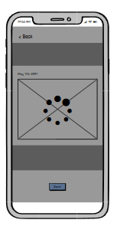
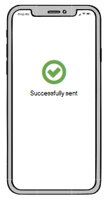





DESIGN 2

Slide 17
STRENGTH
Provides feedback to notice when the processing is executed and completed.
Able to preview the image before sending.
DRAWBACK
Only can select one image/photo each time.
Once sending, unable to cancel the process.

Slide 18
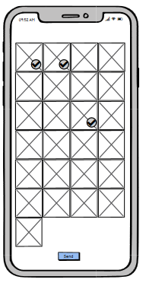
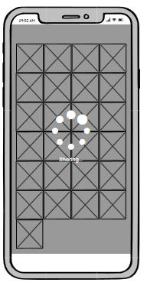
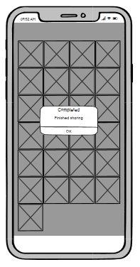





DESIGN 3

Slide 19
STRENGTH
Provides visual feedback (tick symbol on the right corner of the image) to indicate a user which photo has been selected to share.
Provides
DRAWBACK
Small image preview.
Confuse a user the way of selecting a photo due to no instruction like design 1.
Once sending, unable to cancel the process.

Slide 20
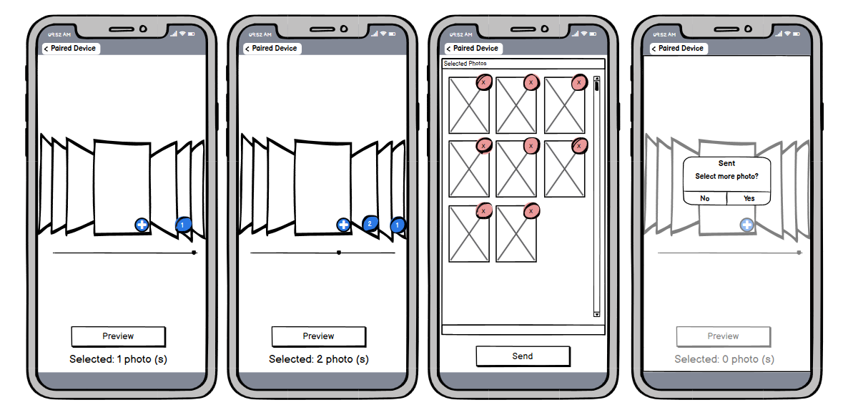





DESIGN 4

Slide 21
STRENGTH
Good preview, clear status of chosen pic.
Easy to deselect photo.
DRAWBACK
Complex procedure (compare to other design)
Can easily pass by desire photo if client swipe too fast.

Slide 22
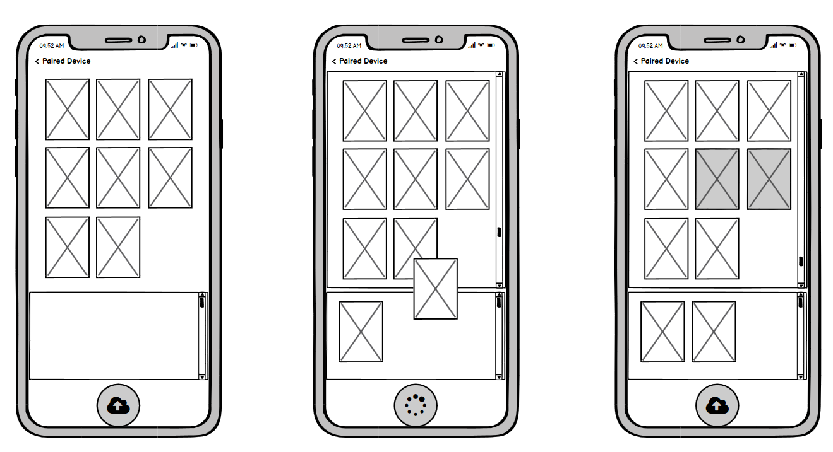
DESIGN 5

Slide 23
STRENGTH
Avoid repeated photo share.
Big target, easy to hit.
DRAWBACK
Complex steps to use.
Take long time to select 1 item (Tap & hold).

Slide 24
Animation: Connecting Devices

Slide 25
DESIGN 3

Slide 26
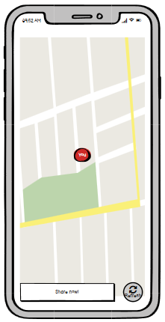
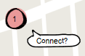
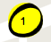
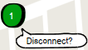


Step 1: Choose device(s)
Tap on one yellow mark (destination device) and select Connect

Slide 27
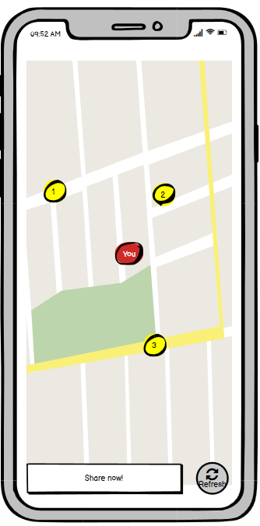

Optional: Refresh
Hit refresh if needed to reload the map and get available devices near you.

Slide 28
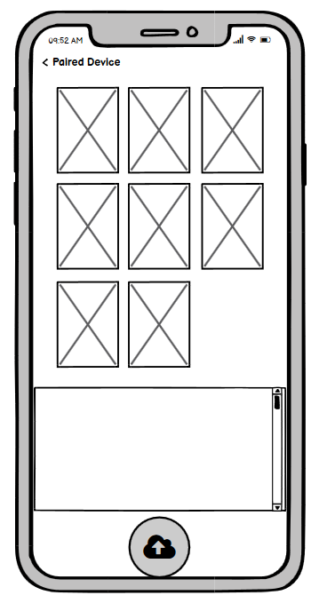
Step 2: Share Now
When select all wanted device, click share now (now enabled).

Slide 29
Animation: Sharing photos

Slide 30
DESIGN 5

Slide 31

Step 1:
Drag a photo to sharing box

Slide 32



Step 2:
Click send

Slide 33
Optional:
Tap X to remove from queue
Click here

Slide 34
-THE END-

